Slide 1
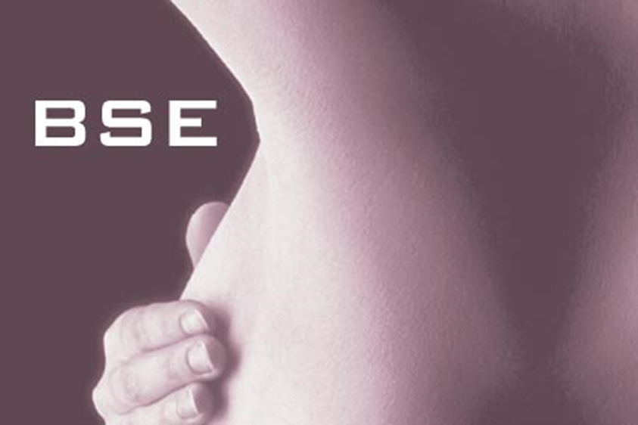
Breast Self Examination
م.م هيله مالك سبتي

Slide 2
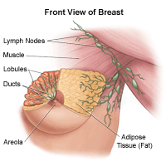
Anatomy of the breast
A breast is made up of three main parts: lobules, ducts, and connective tissue. The lobules are the glands that produce milk. The ducts are tubes that carry milk to the nipple. The connective tissue (which consists of fibrous and fatty tissue) surrounds and holds everything together.

Slide 3
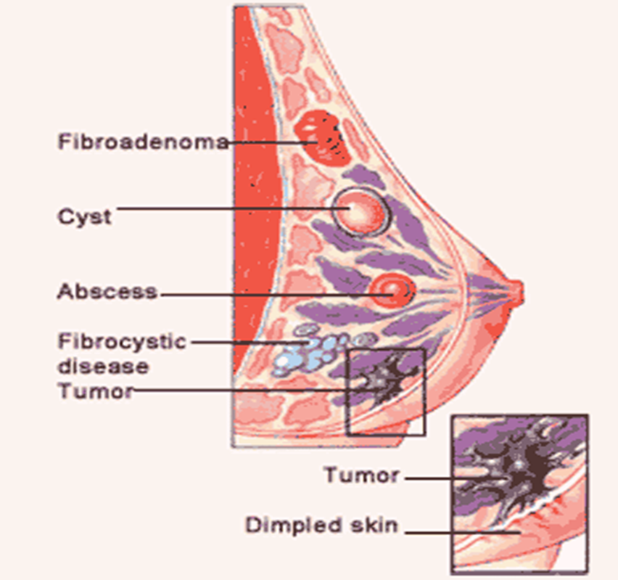

Slide 4
Definition :
A breast self-exam is a screening technique she can do at home to check for breast lumps.
Purpose :
A breast self-exam is a screening technique can do at home to check for breast lumps.

Slide 5
A breast self-exam can help screen for early detection of :
1. tumors
2. cysts
3. other abnormalities in the breasts
Exam:
monthly, day 5-7 of menstrual cycle; after menopause same day each month

Slide 6
Physical assessment findings in a healthy adult
By inspection
By palpation

Slide 7
By inspection the breast should be:
Symmetrical, full, rounded, smooth in all portions, without dumpling, retractions or masses
Faint, even vascular pattern and striae are noted
Nipples everted, areola even
Axillae even color, without masses or rash

Slide 8
Equipment Needed:
The patient must be properly gowned for this examination. All upper body clothing should be removed.
• The procedure used for self-examination using a mirror for inspection.
• Use show and tell; use finger pads

Slide 9
In palpation the breast should be:
Firm and without masses, lumps, local areas with warmth, or tenderness
Nipples should have no discharges
Axillae should be smooth and node are nonpalpable

Slide 10
Steps Breast Self Examination
Step 1
Observe the movement of breast tissue during the following maneuvers:
– Shrug shoulders with hands on hips
– Slowly raise arms above head
– Lean forward with hands on knees (large breasts only)

Slide 11
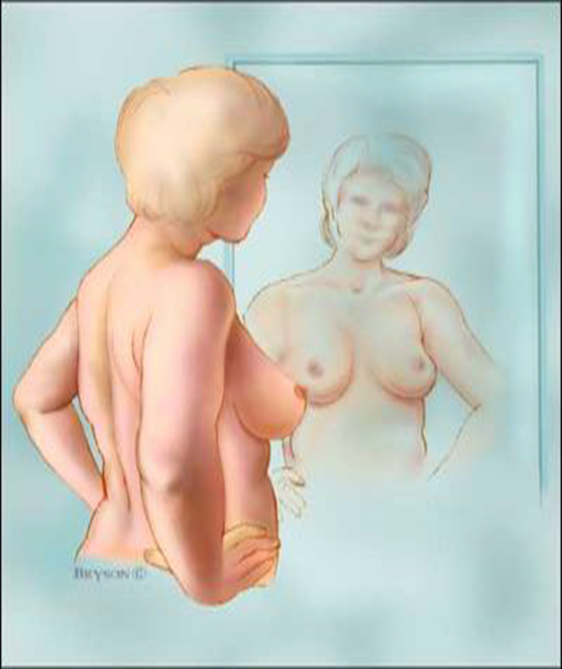
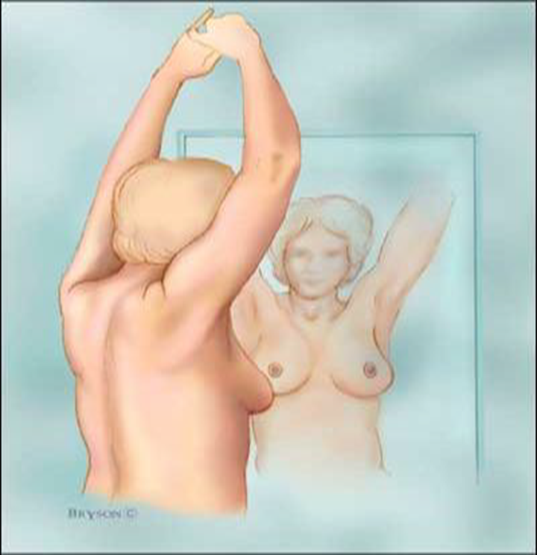

Slide 12
Step 2
• While the woman at the mirror, gently squeeze each nipple between finger and thumb and check for nipple discharge (this could be a milky or yellow fluid or blood).

Slide 13
Step 3
1. Lie down
2. Flatten the breast by placing a pillow under the shoulder on the side being examined.
3. Put one hand behind the head
4. Use finger pads of three middle fingers to feel for lumps or thickening.
5. Press firmly enough to distinguish deferent breast texture.

Slide 14
6. Move around the breast in a set way she can chose the circle movement, up and down line or the wedge movement
7. Use the same way each time to remember how the breast feels.
8. Examine the other breast the same way
9. Inspect the breast while looking in the mirror with the hands at sides look: dimpling of skin, swelling, reddening, asymmetry, or change in the nipple
10. She may want to palpate the breast while taking a shower when the skin is wet and lumps may be easier to feel.

Slide 15
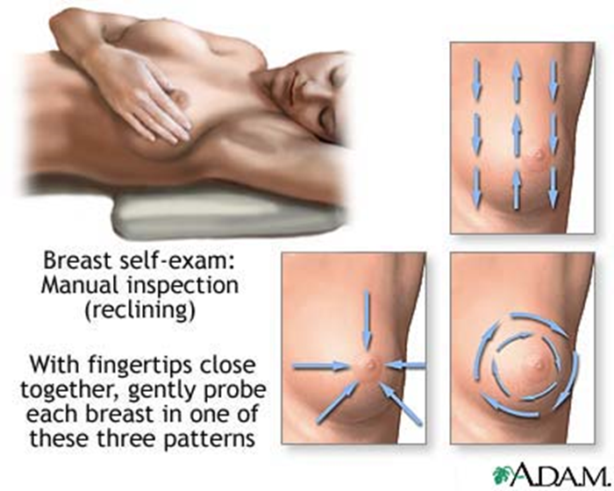

Slide 16
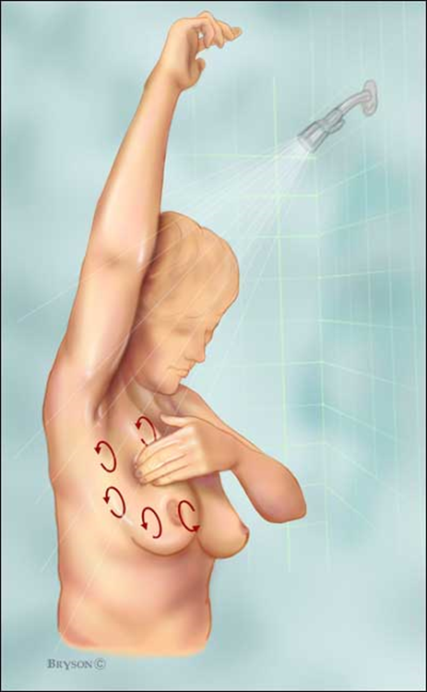

Slide 17


